Slide 1

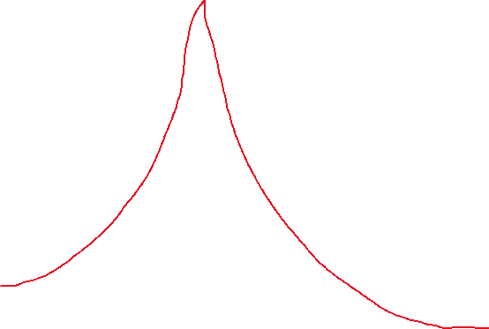


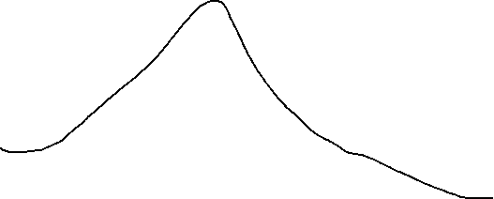
Low damping ratio
Normalized Amplitude
High damping ratio
$$ω_{1}$$
$$ω_{n}$$
$$ω_{2}$$
Frequency Ratio

Slide 2
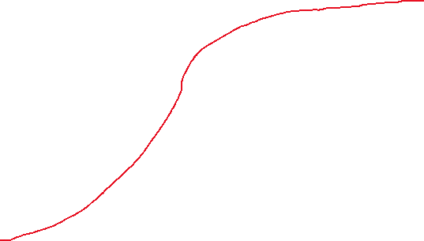
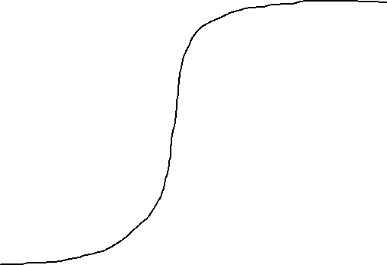
Low damping ratio
High damping ratio
Phase Angle
$$ω_{1}$$
$$ω_{n}$$
$$ω_{2}$$
Frequency Ratio

